Slide 1
Analyzing Ionizing Photon Production Efficiency Using Galfit Sizes Measurements
By: River Schmidt-Eder
Mentor: Anthony Pahl
Notes:
Hi everyone my name is River Schmidt-Eder and I’m studying with Anthony Pahl and in this presentation I’ll be going over some key measurements and values that have been important for our research project of correlating the ionizing photon production efficiencies of galaxies to their effective radii.

Slide 2
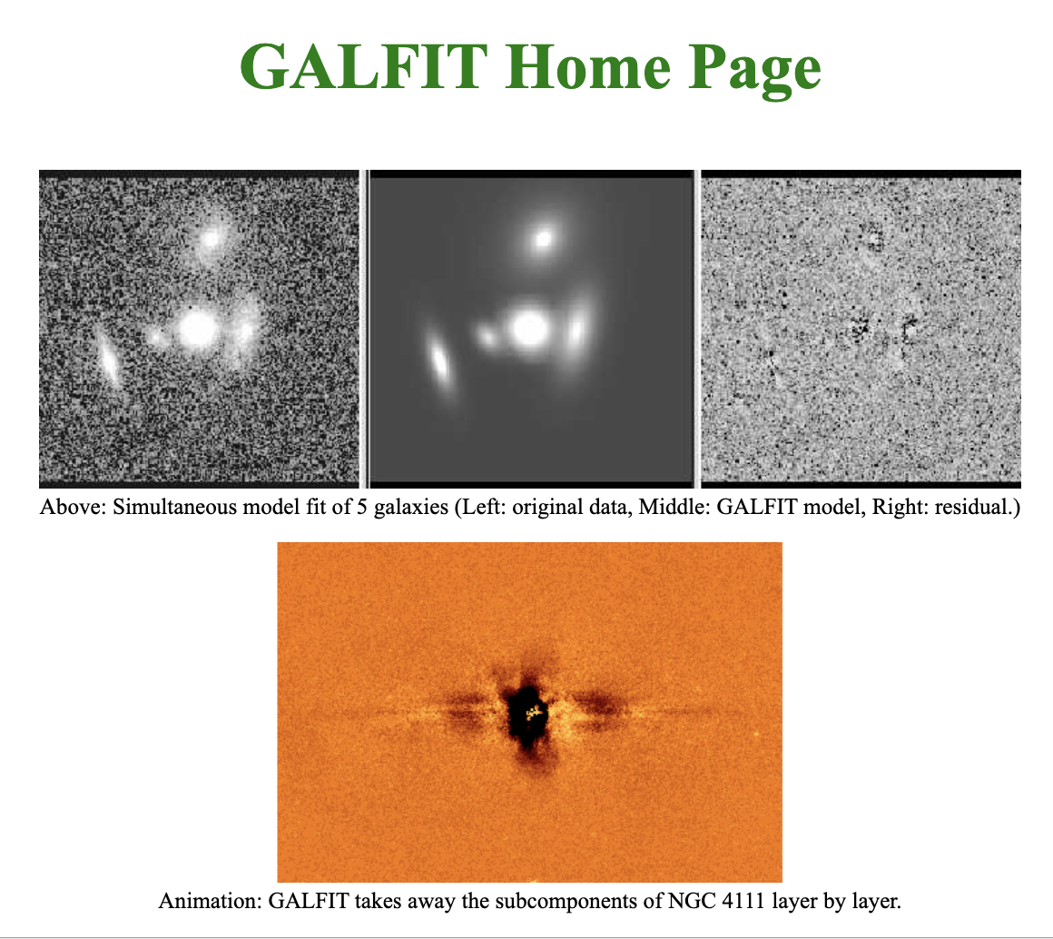
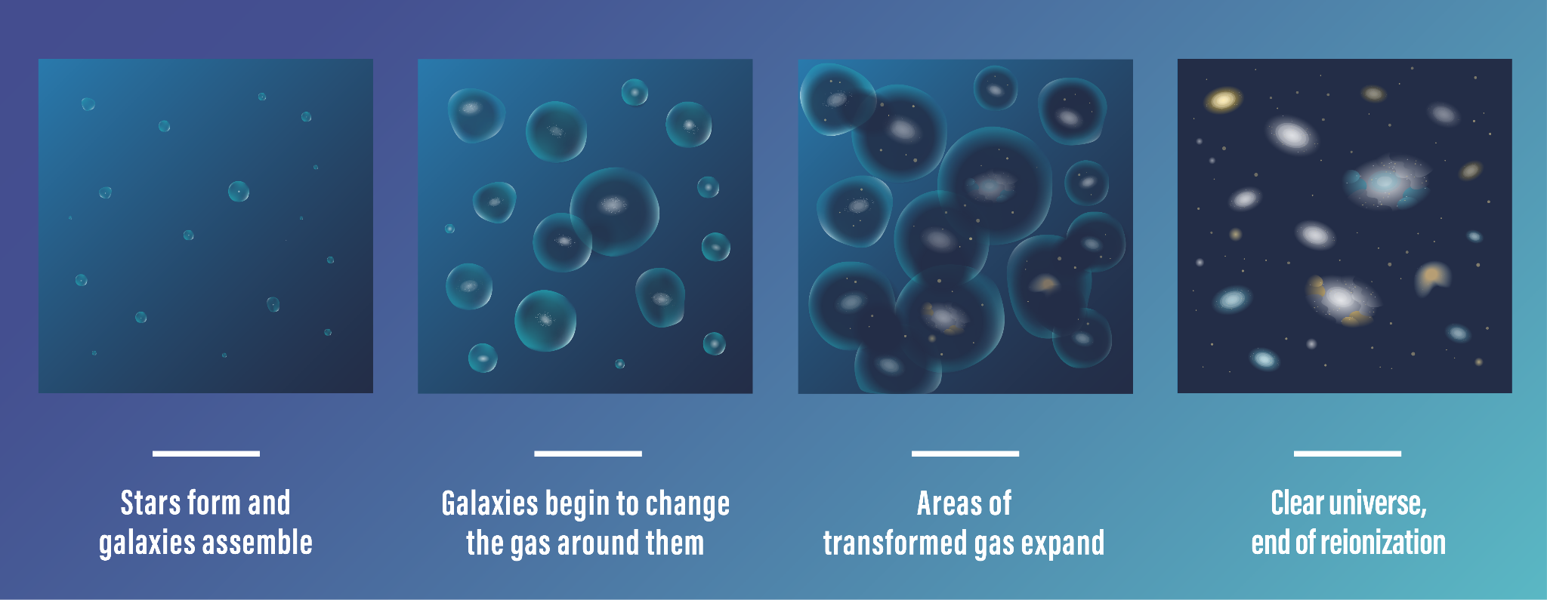
Reintroducing The Project:
Galfit:
Timeline of Reionization:
Peng (2010)
(NASA + 2023)
Notes:
Before we get into some of the values driving our project, here is a quick refresher on what our research is about. For our project, we are correlating the ionizing photon production efficiencies of galaxies, or their production of light capable of ionizing hydrogen with their effective radii or sizes.
We’re doing this to better understand the period of reionization which marks the time in which hydrogen in the intergalactic medium went from neutral to ionized. This period is important because it significantly impacted star formation rates and the formation of galaxies as we know them today.
Our project is specifically interested in correlating the sizes of galaxies to their production of ionizing photons as we think that compact galaxies may have played a more significant role in reionization than scientists currently understand.
For example, it’s already been demonstrated that compact galaxies have had a high fraction of ionizing photons escaping from their stars so if we were to also discover that they were more efficient in producing these photons, we’d be able to categorize them as major contributors to reionization and star formation rates in the early universe.
To try and draw a correlation between ionizing photon production efficiencies and sizes we’re using a program called GALFIT.
GALFIT essentially takes in a bunch of pre-requisites about a galaxy, including its scientific image and a point spread function describing how light is being spread out in an image, to help us better determine the size of a given galaxy. It basically improves our image, giving us a better idea of a galaxy’s size, and for this reason Galfit is pretty much the engine behind our project.

Slide 3
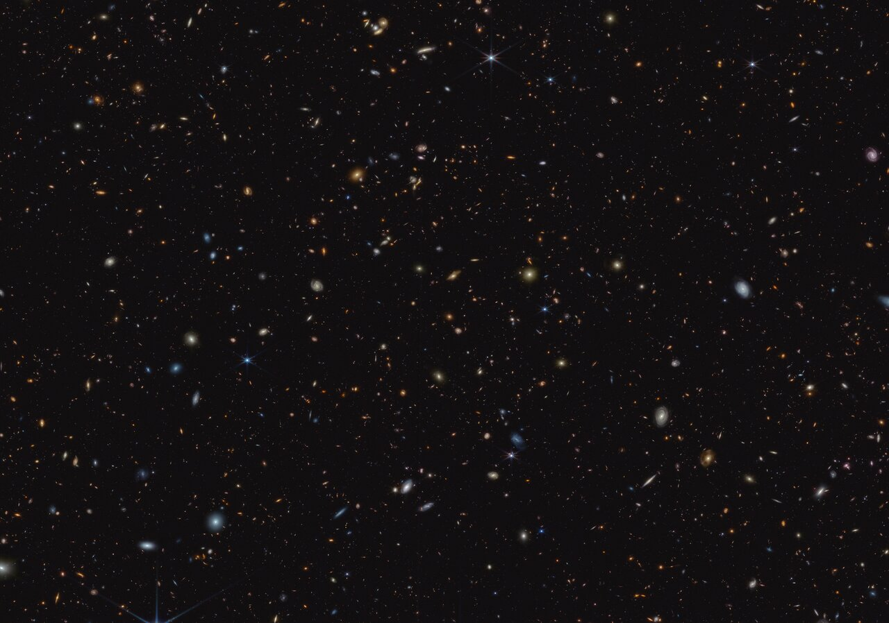
Where is the Data Coming From? (GOODS-S):
NASA (2023)
Notes:
In any case though, before we get into the data driving the research project, I’m going to reintroduce you to where all of this data is coming from and that’s from a section in the sky known as GOODS-S. It comes specifically from the JWST’s Advanced Deep Extragalactic Survey or JADES. The photos were taken at F115W meaning in a 1.15 micrometer wide filter in the near-infrared spectrum. With that out information of the way, let’s get into our actual galaxy models.

Slide 4
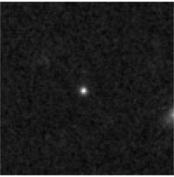
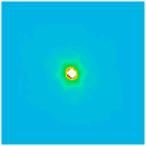
Galaxy Modelling and Fit Parameters:
Science Image:
Model Image:
Fit Parameters:
COMP_1 = 'sersic '
1_XC = '48.6009 +/- 0.0434' /
1_YC = '49.2094 +/- 0.0398' /
1_MAG = '27.2260 +/- 0.0834'
1_RE = '0.7500 +/- 0.0882' /
1_N = '8.0000 +/- 2.9123' /
1_AR = '0.7407 +/- 0.0709' /
1_PA = '22.8080 +/- 12.1326' /
(Schmidt-Eder in Prep)
(Schmidt-Eder in Prep)
Notes:
Alright so pictured here is an example of a galaxy that’s been ran through Galfit. On the left we have the science image of a galaxy and on the right we have the model that Galfit comes up with to help us determine the galaxy’s size.
To create this model we had to feed Galfit a few different things, including the aforementioned point spread function, a cut out of the galaxy in question, and a bad pixel map that would’ve masked out any light from other celestial objects prior to generating our model.
We also had to give Galfit guesses on parameters for what we originally thought those galaxy’s properties were supposed to be, and those variables are shown to my left.
We have variables like “Comp” or component, which tells Galfit what kind of thing we’re attempting to fit to the image. In this case we’re attempting to fit a Sersic profile, which is the name of the equation we’re using to model our light profiles for these galaxies.
Next we have variables like our X center and Y center positions which just tell Galfit where we believe the galaxy is centered in our given image. With the way that we’ve cut out our galaxies they are almost always at around 50, 50 but these values can vary.
Next we have our MAG variable or magnitude value which can vary a lot. Generally these high redshift galaxies will be at around a magnitude of 28, but like I said, it can vary in a case by case basis.
After that we have the RE or effective radius of our galaxy. We can feed Galfit what we think this is by observing pixel positions at the at the centers of our galaxies and recording the difference between those positions and those from our galaxy’s edge.
After RE we have our galaxy’s sersic indexes or N which’ll describe how compact we think the center of the galaxy is in terms of light.
Then we have the AR or axis ratio of the data which we’ll input to describe as the ellipticity of the galaxy or how much more elliptical the galaxy is than circular.
And finally is the galaxy’s positional angle which’ll describe how titled the galaxy is from being upright at 0 degrees. A positive angle will indicate a clockwise rotation, while a negative angle will indicate a counterclockwise rotation.
After everything has been plugged in, and we allow Galfit to run, it’ll further programmatically determine what these parameters are based on what it can determine in the science image, and in the end it’ll spit out its own parameter list with what it thinks the properties of the galaxies really are, and it’ll include pluses and minuses which will serve as confidence intervals for our data.

Slide 5
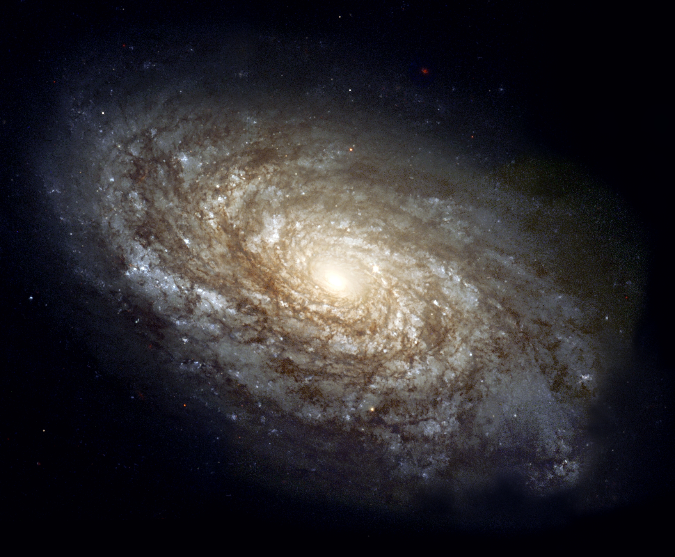
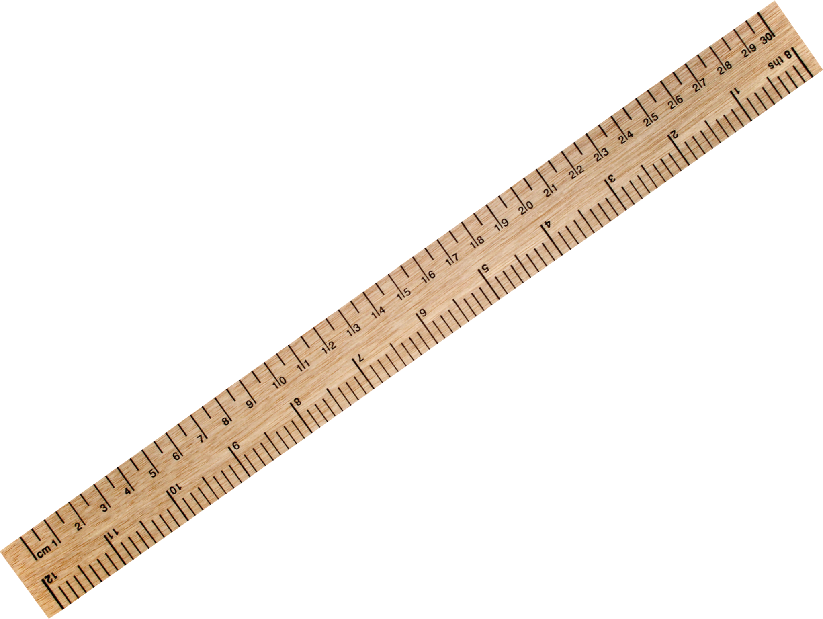
Calculating an Effective Radius in Physical Units:
Effective Radius (Pixels)
How Big Is This?
X
sqrt(Axis Ratio)
X
Arcseconds/Pixel
=
Effective Radius in Physical Units
(can convert to kpc)
(NASA 1999)
(PngImg 2024)
Notes:
After Galfit spits out data for a galaxy based off of what we’ve given it, we have to go through the process of converting the pixels that we have for the sizes of the galaxies to actual distances in physical units.
This is a little bit difficult because when we get the radius measurements from our Galfit model they’re actually measured along this thing called an elongated axis which’ll be the distance between the galaxy’s two furthest points which is usually an elliptical shape.
To correct that elliptical distance to a circle we’ll multiply what we have for the pixel value of the radius by the square root of the axis ratio which’ll be the shortest diameter of the ellipse over the longer diameter of the ellipse for a galaxy, and doing this will convert that elliptical measurement into a circular one.
Then we have to convert that pixel value into this thing known as an angular size. All of our images will have a arcseconds per pixel value which we’ll multiply our new pixel value by to get the distance of the galaxy in arcseconds.
After everything’s been said and done we’ll finally get the radius in arcseconds for that specific object, which we can further convert into kiloparsecs via a function.

Slide 6
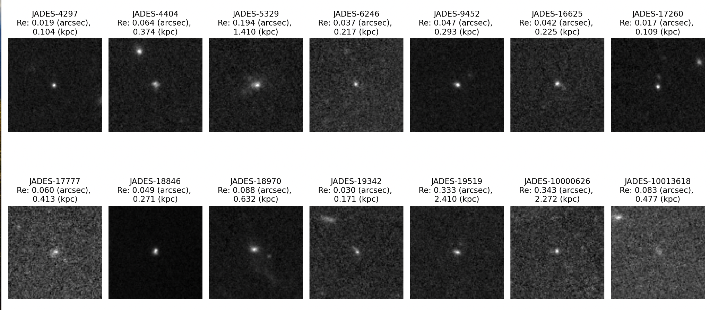
What Do We Have So Far?
(Schmidt-Eder in Prep)
Notes:
So what do we have so far? So far we’ve gathered the prerequisites and made the calculations necessary to fit 14 out of the 40 galaxies to get their effective radii.
As you can see, there’s a bit of variation in the sizes of these galaxies with sizes ranging from 0.1 to 2.4 kiloparsecs.
As we’ve just begun the fitting process, we’re looking at galaxies with relatively simple morphologies as they are the easiest to run through Galfit and do calculations on. These galaxies definitely do vary in shape beyond what you’re seeing here though. If you look at that third galaxy, for example, you’ll notice that it has a bit of a plume to its left, while looking at a galaxy such as the one pictured first shows less of a light variation from that same center.

Slide 7
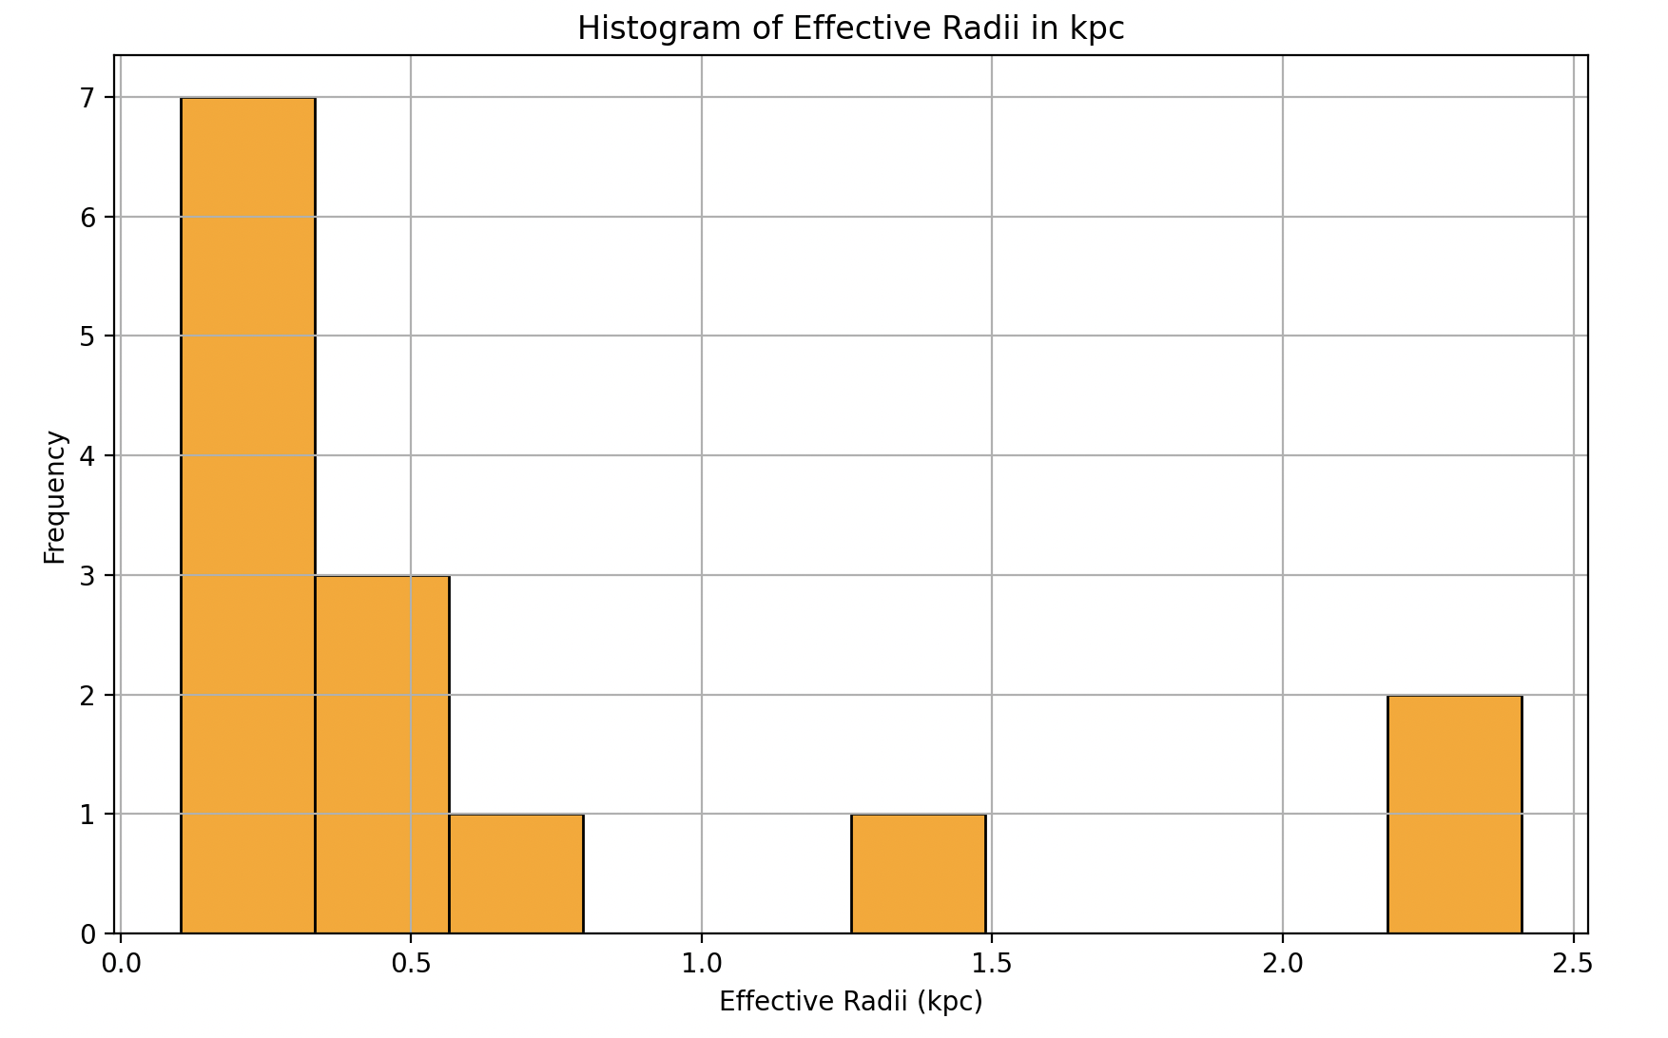
Effective Radii Histogram:
(Schmidt-Eder in Prep)
Notes:
Pictured in this slide is a histogram from which I’ve plotted the frequency of galaxies of certain sizes on the y-axis with the effective radii in kiloparsecs of those galaxies on the x-axis with spacings of 0.25 kiloparsecs for each bin.
You’ll notice that for the data we have so far, there were a lot of galaxies between 0 and 0.75 in terms of their effective radii. This is pretty small for a redshift we’re studying at, but it's important to remember that the data we have is biased at the moment since we’ve only made size calculations for galaxies with simple morphologies. It’s reasonable to say that the galaxies with more complicated morphologies will also be puffier and larger than what we’re seeing with the current galaxies we have now.

Slide 8
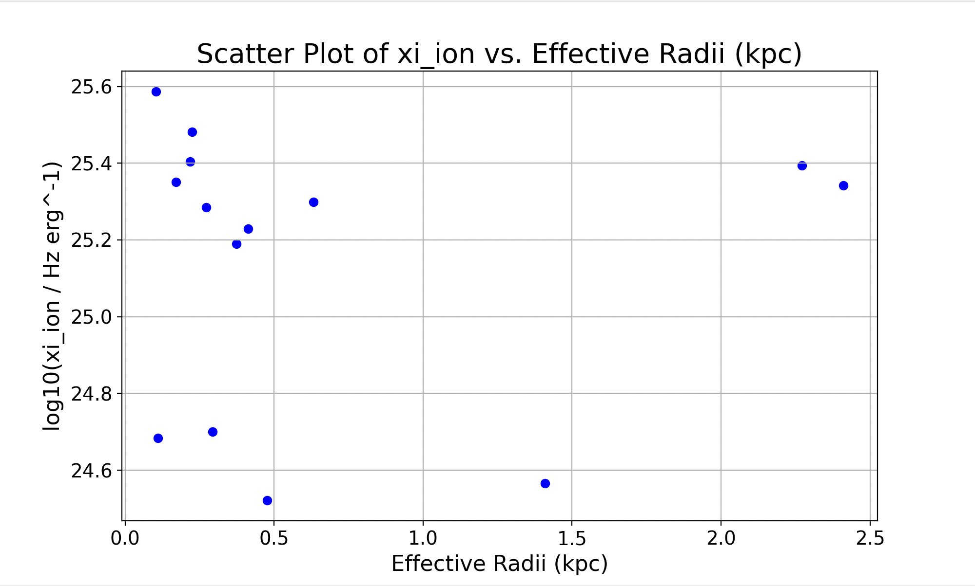
Effective Radii to Ionizing Photon Production Efficiency:
(Schmidt-Eder in Prep)
Notes:
Anyway, if we now compare the effective radii of these galaxies in kiloparsecs seen on the x-axis to their ionizing photon production efficiencies seen on the y-axis you’ll see that it’s showing a relatively low ionizing photon production efficiency for galaxies with low sizes at the moment.
(What the units mean: The equation takes the logarithm (base 10) of the ionizing photon production efficiency divided by the units of Hz and erg^-1. It simplifies to the logarithm of the efficiency with specific units (Hz and erg^-1) factored in.)
xi_ion ~ 10^25 erg / Hz, so -> log(xi_ion / (erg Hz^-1)) = 25

Slide 9
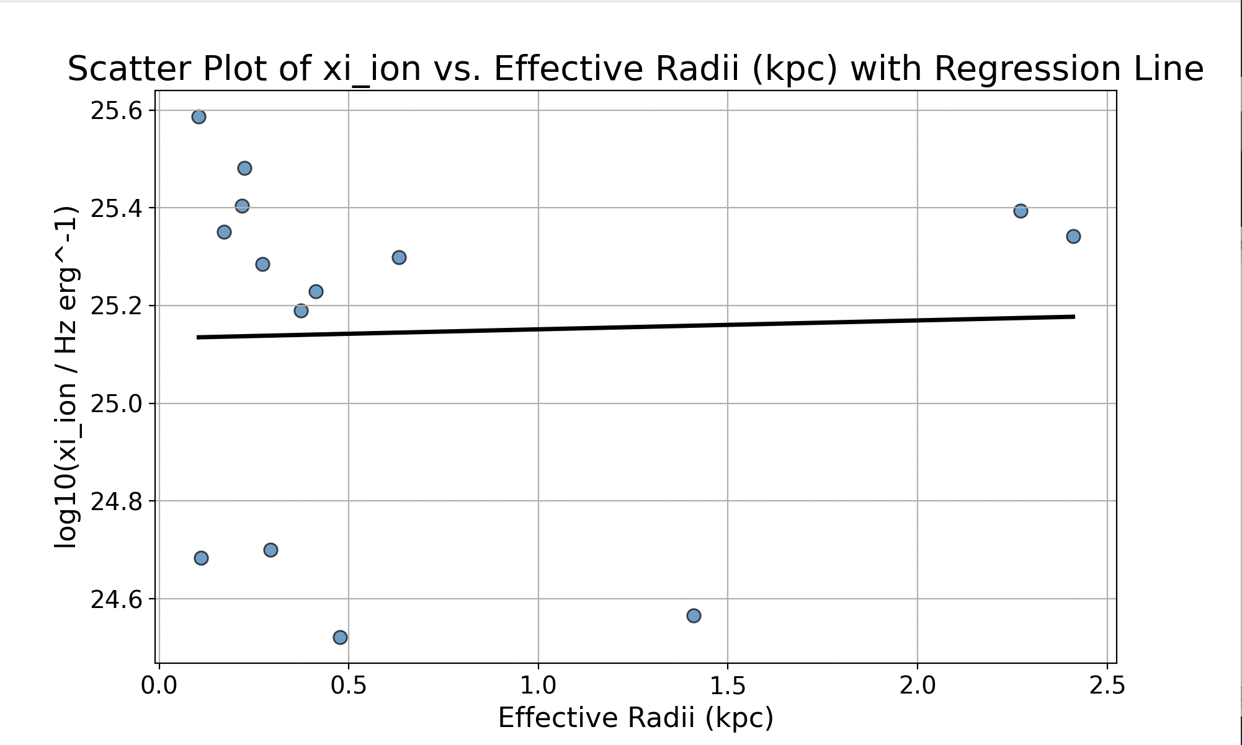
Now the Same Graph with a Regression Line:
(Schmidt-Eder in Prep)
Notes:
Fitting this graph with a regression line, we get a line with a slope of 0.018 giving us an almost flat line which currently isn’t great for suggesting a correlation. Basically it tells use that for every one change in kiloparsec we get a change of about 0.018 in ionizing photon production efficiencies. What we’ll use later on in the project will be a spearman’s correlation test to better determine the correlation between the two variables. We’re going to do that with a full sample which will give us a better idea of what’s going on since our data is currently biased.

Slide 10

Potential Implications:
(Artur Szczybylo 2018)
Notes:
All that stuff aside, what are our current potential implications for our data? Basically for our two current potential implications we have that compact galaxies either are or aren’t efficiently producing ionizing photons suggesting that there either is or isn’t a correlation between size and ionizing photon production efficiencies.
Either way, even if it is the case that smaller galaxies aren’t better at efficiently producing ionizing photons, we still know that they made more of an impact on reionization than other galaxies due to their demonstrated high escape fractions compared to other galaxies. Once we have the full data on the ionizing photon production efficiencies our conclusions will be much more concrete.

Slide 11
Questions? (Sources)
References
Fan, X., Carilli, C. L., & Keating, B. 2006, , 44, 415,
doi: http://doi.org/10.1146/annurev.astro.44.051905.09251410.1146/annurev.astro.44.051905.092514
Flury, S. R., Jaskot, A. E., Ferguson, H. C., et al. 2022, , 260, 1,
doi: http://doi.org/10.3847/1538-4365/ac533110.3847/1538-4365/ac5331
3
Robertson, B. E., Ellis, R. S., Furlanetto, S. R., & Dunlop, J. S. 2015,
, 802, L19, doi: http://doi.org/10.1088/2041-8205/802/2/L1910.1088/2041-
8205/802/2/L19
4
Notes:
And that is the end of my presentation I will now take questions.
Questions if asked:
Ionizable by the light:
“Hydrogen (H): 13.6 eV
Helium (He): 24.6 eV
Carbon (C): 11.3 eV
Nitrogen (N): 14.5 eV
Oxygen (O): 13.6 eV
Neon (Ne): 21.6 eV
Silicon (Si): 8.2 eV
Sulfur (S): 10.4 eV”
How metallicity affects ionizing photon production efficiency: “Stars with higher metallicity tend to produce fewer ionizing photons compared to stars with lower metallicity. Metals in stars absorb some of the ultraviolet (UV) radiation, reducing the number of ionizing photons that escape the star. This absorption is due to line blanketing, where various metal lines absorb specific wavelengths of light.” ← Metals in the stellar atmosphere can absorb ionizing photons before they leave the stars atmosphere leading to less ionizing photon production.

